Slide 1
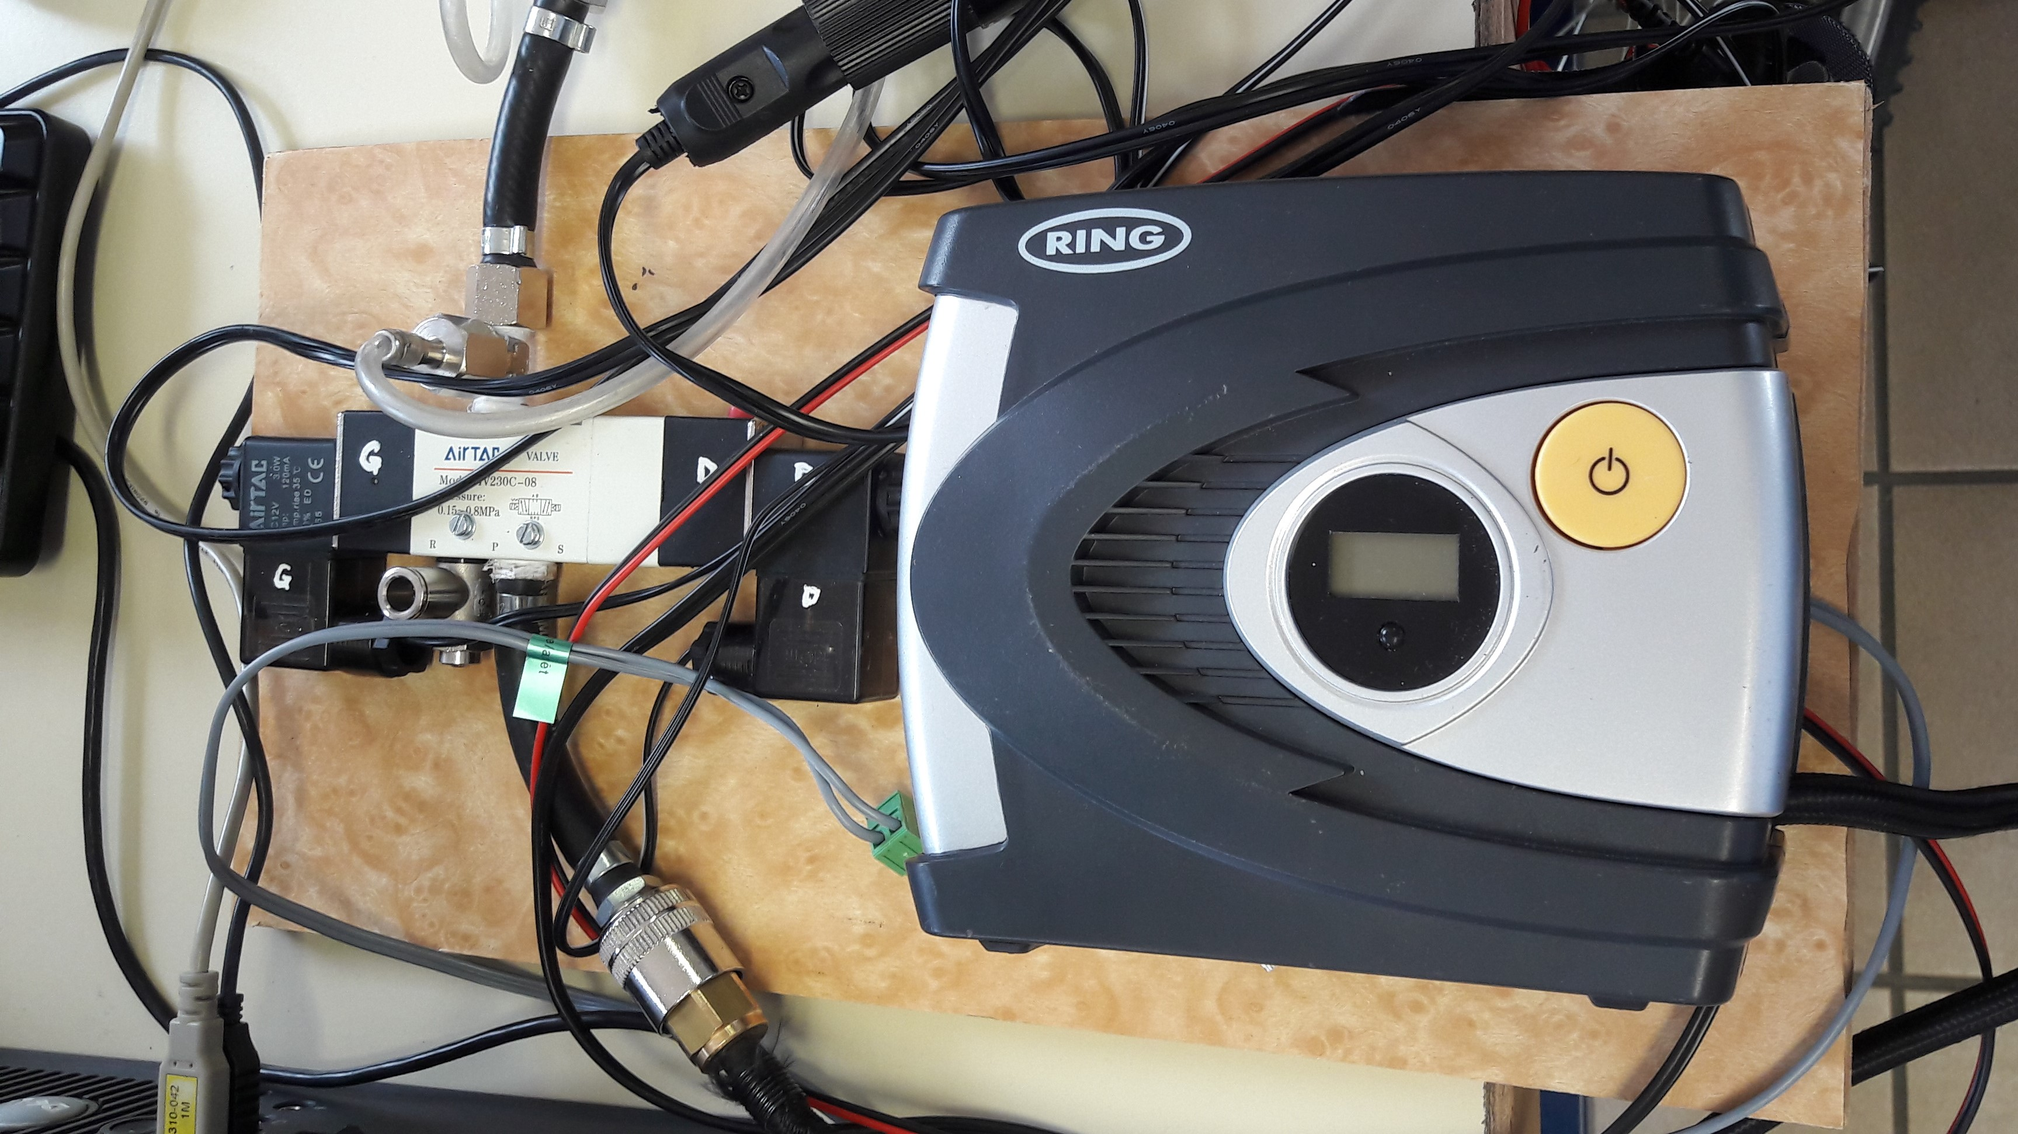
Autonomous inflator
Perez Romain
TSTI2D 2017/2018

Slide 2
1- Presentation :
Automation of the pump
Inflation management
Battery charge optimization

Slide 3
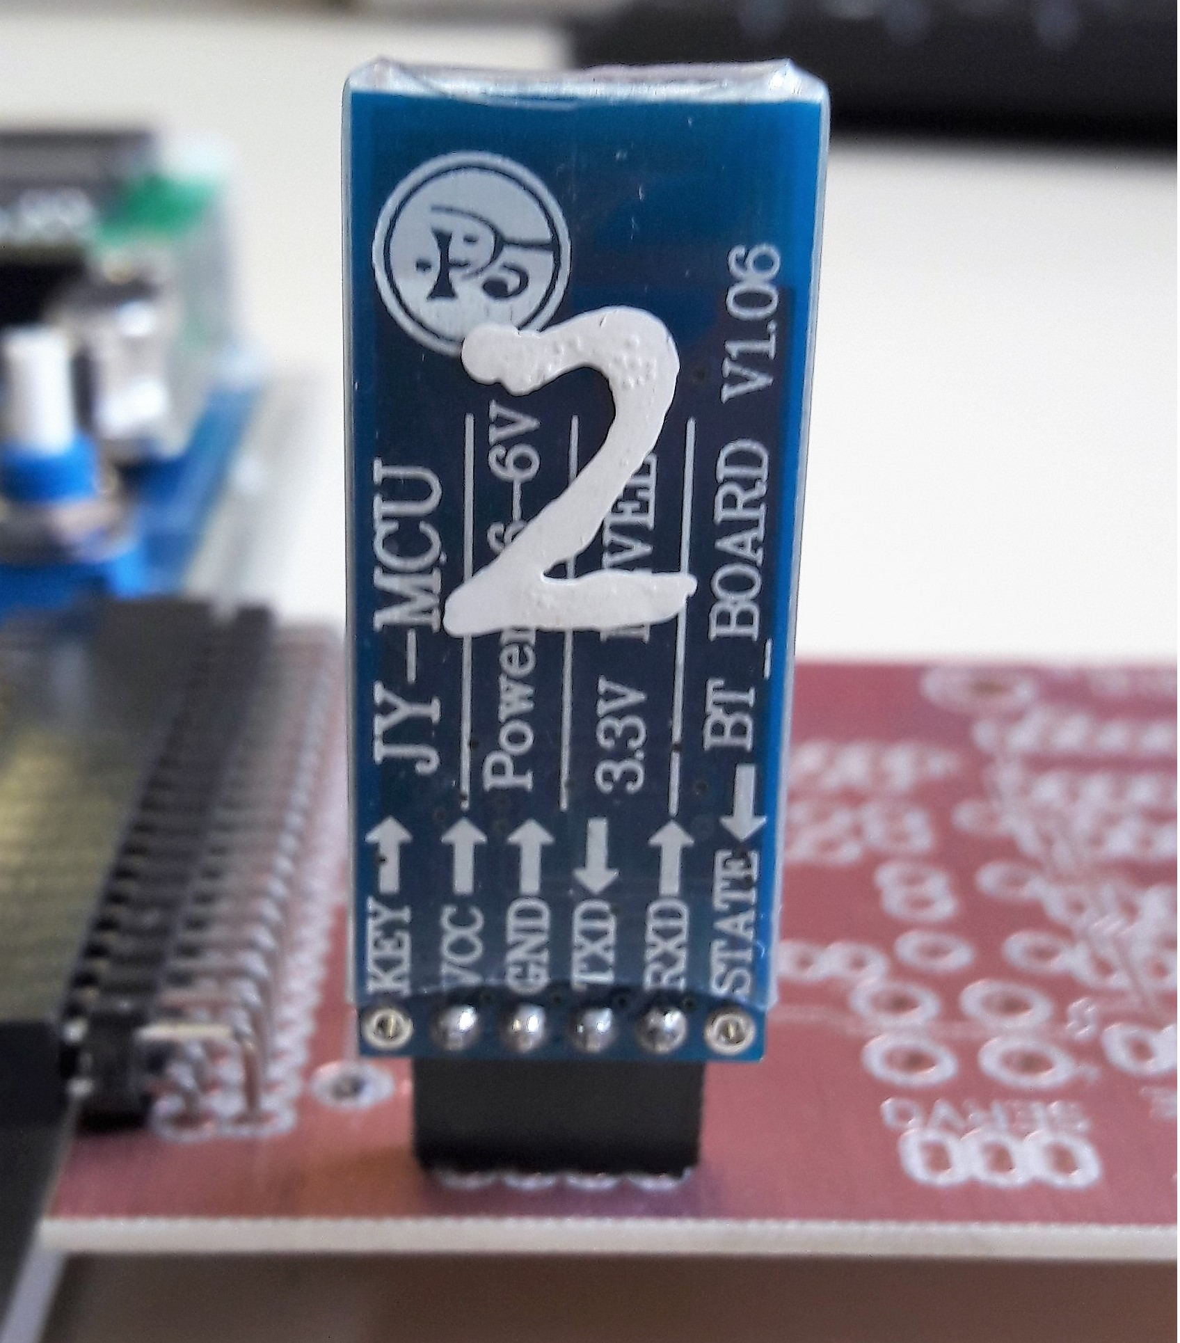


2- How does it work ?

Slide 4
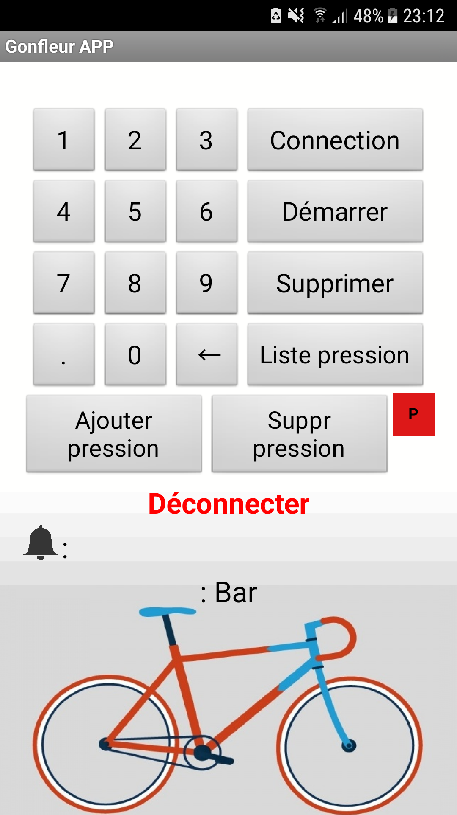

2- How does it work ?

Slide 5





3- Advantages / Disadvantages :

Slide 6
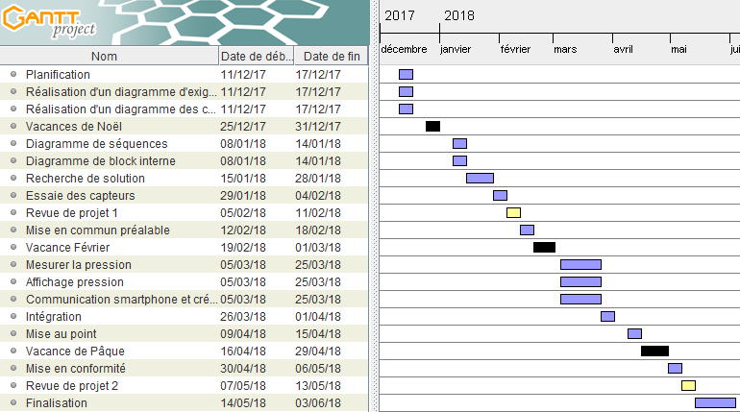
4- The following of the project :
: actions implemented
: holidays
: project review
: time spent

